Slide 1
CyberMiner
Collin Matz
Fredrick Horn
Parker Tate
Conner Carraher
Joshua Brown
Jacob Danel
Team website: https://cs4376-team-a.github.io/Project/

Slide 2
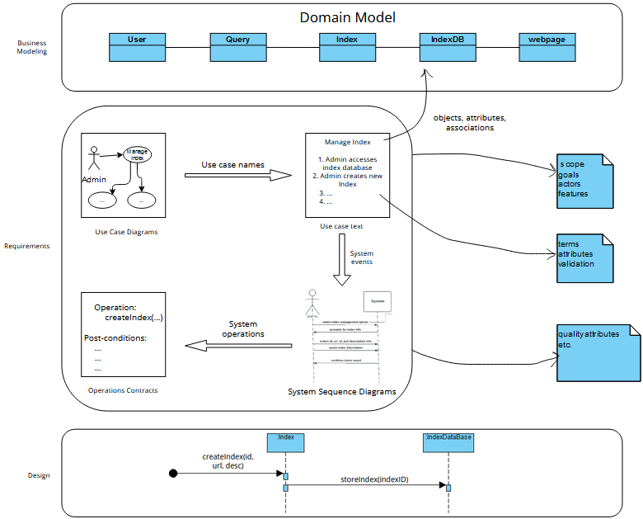
General Overview

Slide 3
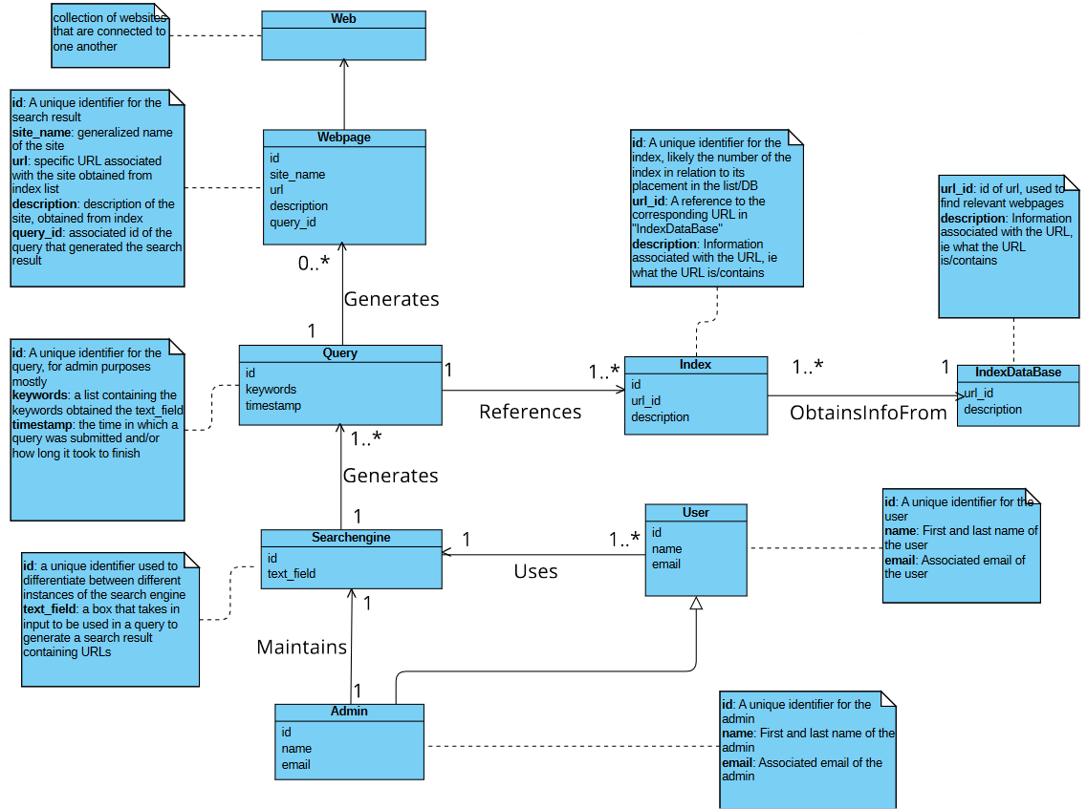
Domain Model
Rough layout of system
General flow is user/admin -> uses search engine -> generates query -> query uses keywords to search index table for relevant websites -> query then generates/opens webpage with list or relevant URLs
**subject to change**

Slide 4
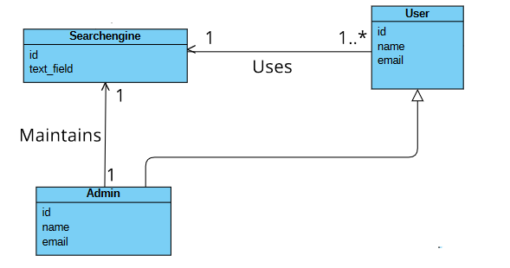
Domain Model - User/Admin interaction
Two different user types in CyberMiner system
Admin is a specialization of User
User: A typical user of the system that will perform basic functions through search engine (submit keywords and go to websites listed)
Admin: Can perform same basic functions same as generic users, also has added permissions/functionality that helps them in maintaining the system

Slide 5
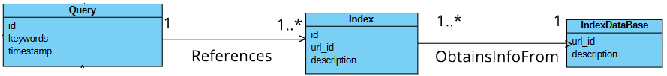
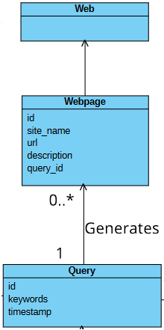
Domain Model - Index and Web Page Interaction
A Query from the search engine will reference an index from the index database using keywords obtained from the user that exist within the index’s description
The index/indices will then be used to obtain the necessary info (namely the url) from the Index Database
Query from search engine will generate a web page (or pages) with a list of urls that are relevant to the keywords the user submitted
User will then be able to click on one of the results to then go to that specific site

Slide 6
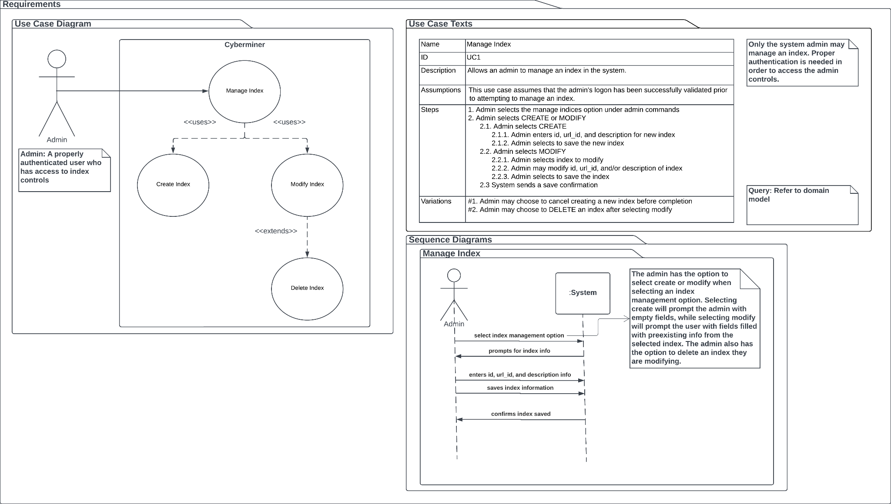

Slide 7
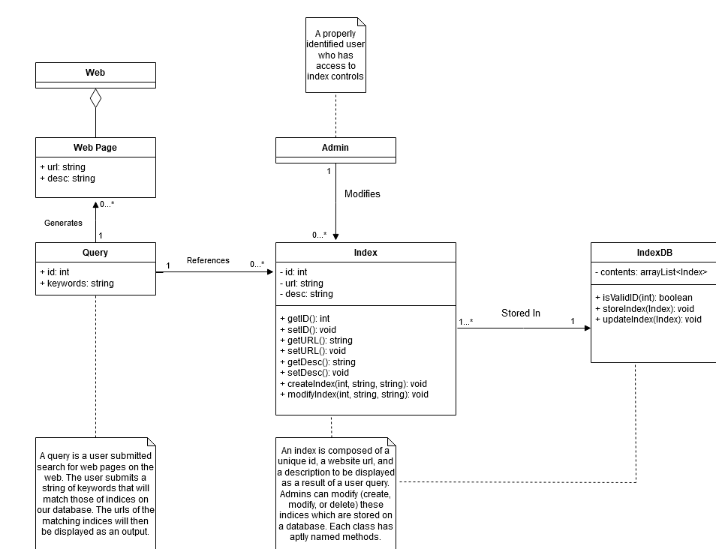
Design Model

Slide 8
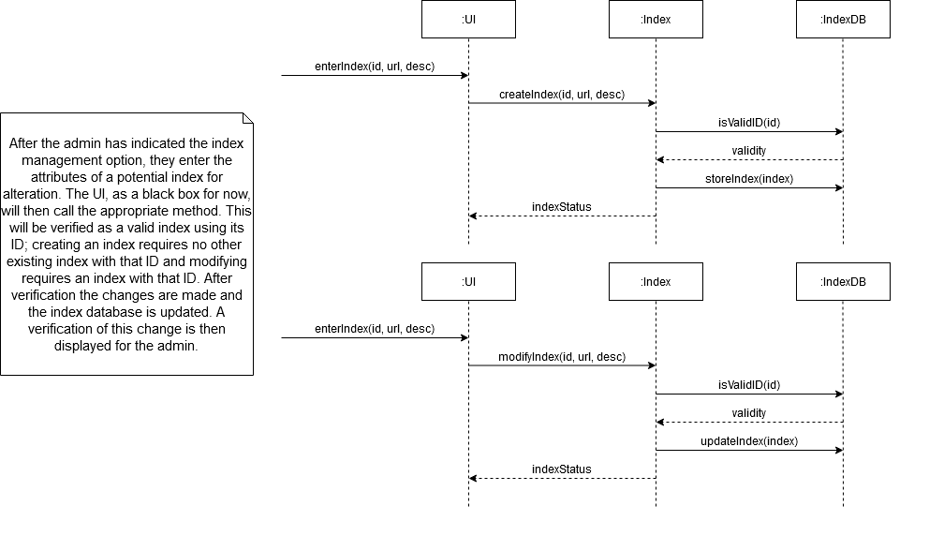
Design Model

Slide 9
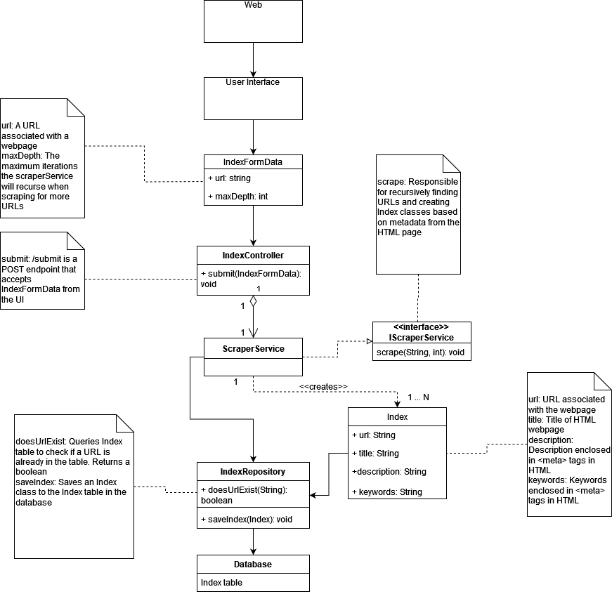
Implementation

Slide 10
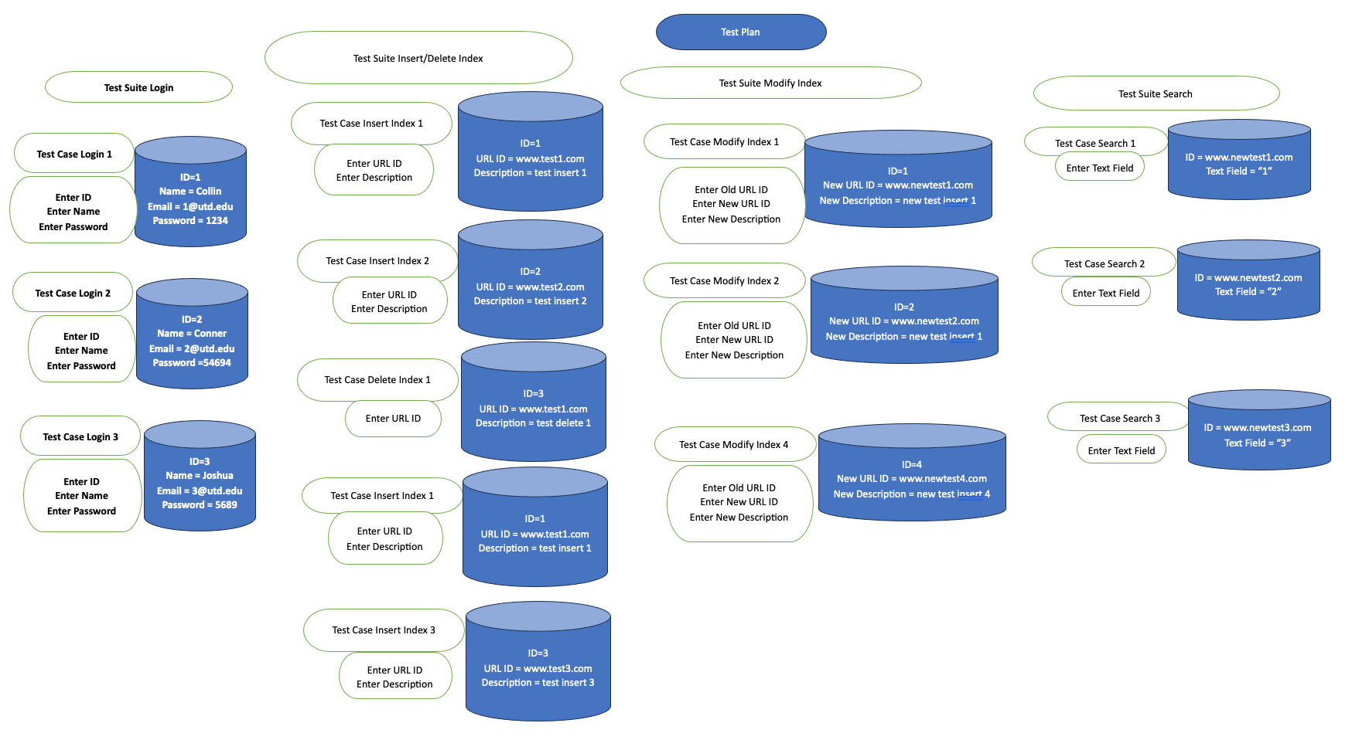
Testing

